Slide 1
MORE IMPORTANT THAN SHOES!
Let’s Sing Healthy!
Karen Breidert

Slide 2
Let’s work on singing instead of working on songs!

Slide 3
BEAUTIFUL SINGING IS:
WELL SUPPORTED
FREELY PRODUCED
RESONANT

Slide 4
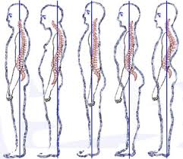
WELL SUPPORTED
POSTURE

Slide 5
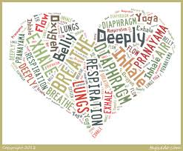
WELL SUPPORTED
BREATHING

Slide 6
BREATH SUPPORT
VS.
BREATH MANAGEMENT

Slide 7
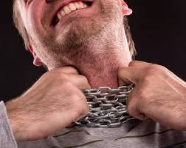
FREELY PRODUCED

Slide 8
RESONANT

Slide 9
TEN STEPS TOWARD VOCAL HEALTH
Maintain your body’s optimum water level.
Get enough rest.
Quit smoking.
Eat right.
Exercise and stay physically fit.

Slide 10
Laugh, be merry, watch for stress indicators.
Do not sing with an inflamed or sore throat.
Work through emotional conflicts.
Use a supported speaking voice.
Balance voice use with voice recovery time.

Slide 11
“All owls should be ousted from elm trees.”

Slide 12
CLOSURE
From the 10 Steps Toward Vocal Health:
Name one or two that you already practice consistently.
Name one or two that you’d like to incorporate into your life right away!

