Slide 1
Site Search 2014
Lake Ontario Region 16

Slide 2
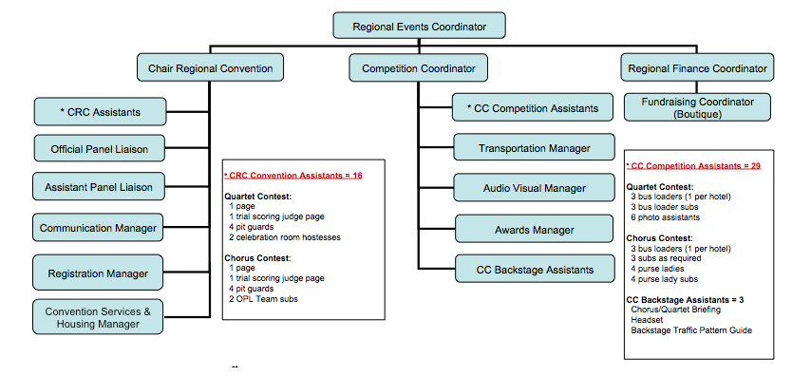
Convention Team

Slide 3
Task Timeline: June - Aug
Verify hotel and competition venue contracts
Verify Audio/Visual, Photography and Webcasting contracts
Confirm theme of Fall Music School
Confirm with Regional Education Coordinator (EDC) that an education class will be run at Spring Contest
Provide following year Convention Team names and contact information to Regional Communication Coordinator (CoC)
CRC Ramp-up email to Team
Prepare draft Convention Handbook
Revise forms and forward to Webmaster
Request hotel assignments from Housing Manager & Regional Assessment Date from Regional Finance Coordinator for inclusion in Convention Handbook.

Slide 4
Task Timeline: Sep - Nov
Expect first Communiqué from SAI with deadlines (for inclusion in Convention Handbook)
Prepare draft budget and circulate to Regional Events Coordinator (EVC), Regional Finance Coordinator (FC) and Competition Coordinator (CC) for input and feedback
Prepare for Fall Music School class
Finalize budget
CRC Welcome note to Judges - send Convention Handbook for their information
Team status report due October 31st
Expect Competition Update from SAI

Slide 5
Task Timeline: Jan - Feb
Expect email from SAI regarding Panel Secretary printer requirements. Forwarded to OPL Team for action.
Start receiving weekly SAI Box Reports (registered contestants!) – share with Communications Manager for Program Planning purposes
Team status reports due January 31st
Work with EVC and CC to select contest emcees
Expect confirmation e-mail from SAI re Trial Scoring Judges
Send note of appreciation to Directors and Team Leader/President for each Convention Team Portfolio Manager
Confirm Team housing assignments at contest.
E-mail Regional Education Coordinator re Education Class on Friday morning (faculty and theme).
Provide details to Communications Manager for inclusion in Convention Program and CC for inclusion in Chorus and Quartet Supplements.

Slide 6
Task Timeline: March
Call for volunteers (non competing choruses, CAL).
Reminder to Team – status reports due March 31st
Email all choruses and quartets asking for names of VIPs accompanying them at contest.
Email COMP AEB list to Housing Manager
Coordinate press release with Regional Communication Coordinator and send to the city
Email RMT Director’s Coordinator and Membership Coordinator re Leadership Recognition from podium during chorus contest

Slide 7
Task Timeline: more March …
Email RMT Membership Coordinator and Team Leader re First Timer Ribbons and table set-up at Thursday night Briefing at contest
Greetings from CRC to city where convention is being held
Invitation out to Pit Guards and Pages
Send CRC Welcome letter for program to Communication Manager
Prepare list of choruses and convention team members per hotel to send to hotels with Check-in policy
Send list of available volunteers from non-competing choruses and CAL members to Convention Team Portfolio managers
Hello to judges – countdown is on!

Slide 8
Task Timeline: a bit more March…
Note to Team re Wednesday night Team Soirée/Working Bee
Finalize Precon times with Convention Services Manager Greetings from CRC to hotel main contacts (include check-in policy; list of choruses at each hotel and authorized person to pick up chorus packages; list of Convention Team Members at hotel).
Email Pit Guard, Page Instructions and VIP Instructions for to Convention assistants and VIPs. Check with Team to determine if anyone has a position Shadow or no
Prepare labels and envelopes for VIP ribbons
Prepare labels for chorus CCL Check-In bundles

Slide 9
Task Timeline: the last of March…
Prepare competitor card bags to be put out at Thursday night Briefing
Email Check-in policy reminder to choruses and quartets
Provide webcast and audio visual staff names to Registration Manager for preparation of complimentary AEB
Receive confirmation of all Convention Assistants; finalize all expense forms and Reimbursement spreadsheet for Regional Finance Coordinator
Expect backstage schedules and chorus rehearsal schedules from CC

Slide 10
Task Timeline: home stretch
TWO WEEKS PRIOR TO CONTEST:
  Prepare and distribute Team “Where To Next” schedule
  Prepare Team Member Packages for Wednesday night distribution
  Prepare hotel handouts for Pre-Cons
  Buy gifts for emcees
  Prepare Convention Team Member Packages:
WORKING BEE:
  CCL REGISTRATION PACKAGE CONTENT
    AEB Programs
    VIP ribbons
    Other
Notes:
Prepare Convention Team Member Packages:
Expense Form (including respective convention assistants)
“Where To Next” schedule
Chorus contact information per hotel
Check-In Procedure
VIP and Pit Guard Procedure

Slide 11
POST COMPETITION
Sunday Morning
  Finance Coordinator meets with all hotels to settle all bills
  Contest Wrap –up meeting
  Cracker Barrel and head home!
May
Portfolio Managers complete final reports
Complete International reports (CC Evaluation and CRC Post Competition Report)
CRC prepares Convention Report for RMT June meeting …
THIS IS THE SONG THAT NEVER ENDS!!!!

Slide 12
Site Search Task Force
When Harmonic Progression was announced, the RMT appointed a Site Search Task Force:
  Sandy Blamowski, Events Coordinator
  April Jackson, Finance Coordinator
  Shelley Snoulten, Competition Coordinator
  JD Crowe, Chair Regional Convention

Slide 13
Task Force Mandate
Establish Site Search Criteria taking into consideration:
  Suitability of contest venue (in accordance with International Competition criteria for lighting, sound, judging facility and rest areas, etc.)
  Hotel availability
  Busing availability if required
  Cost
Establish a Site Search Committee to identify potential sites in all corners of the region

Slide 14
Site Search Committee
Thank You!!
          Linda Morrison
          Sharon Towner
          Suzie Thomson Lafosse
          Alynne Miller
Using the site search criteria templates, they presented the Task Force with 7 potential sites – considered 15 in total. Some of them met some of the criteria but only four (4) met most of the criteria. Those four (4) potential new sites and Syracuse were considered by the Task Force.

Slide 15
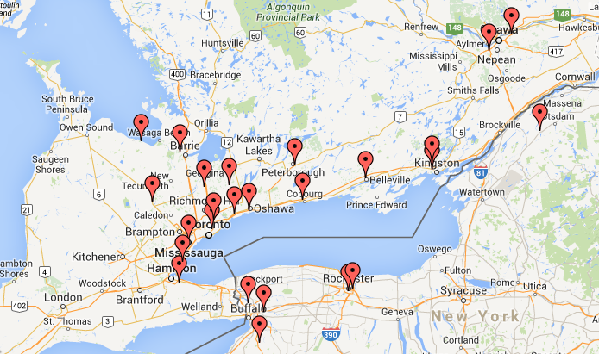
Our Geography!

Slide 16
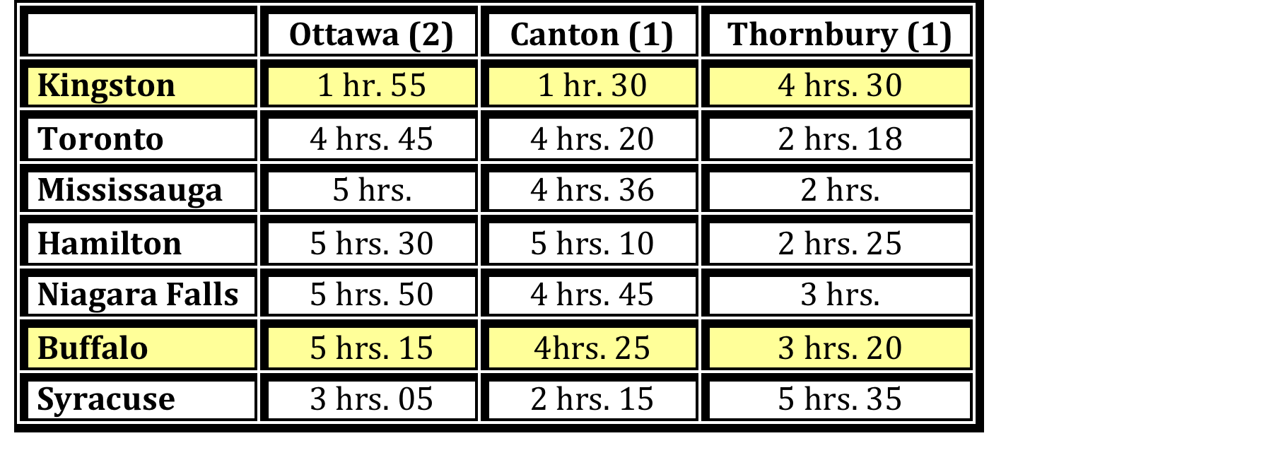
NAVIGATING OUR REGION!

Slide 17
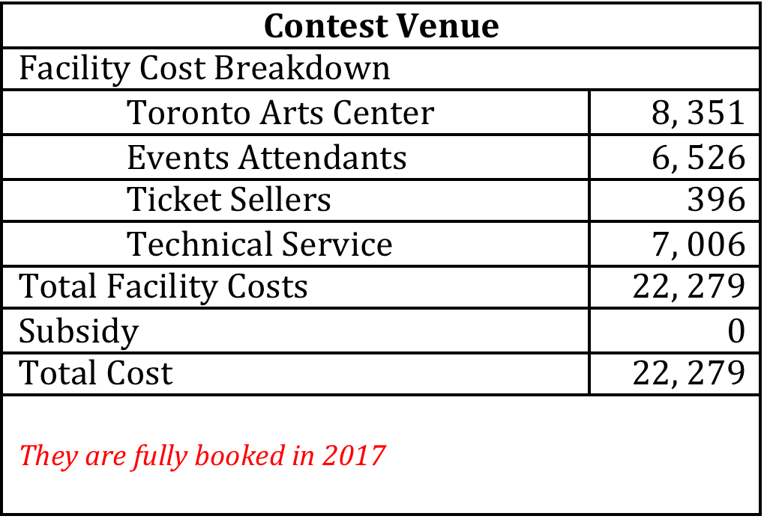

Toronto

Slide 18
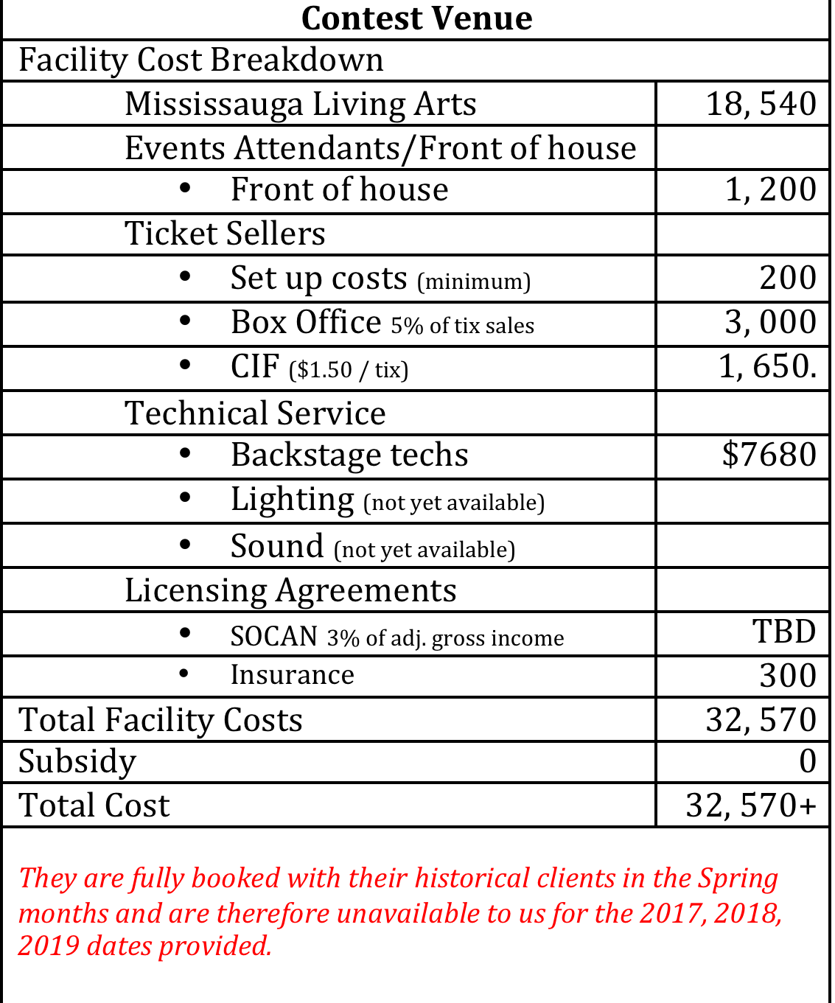
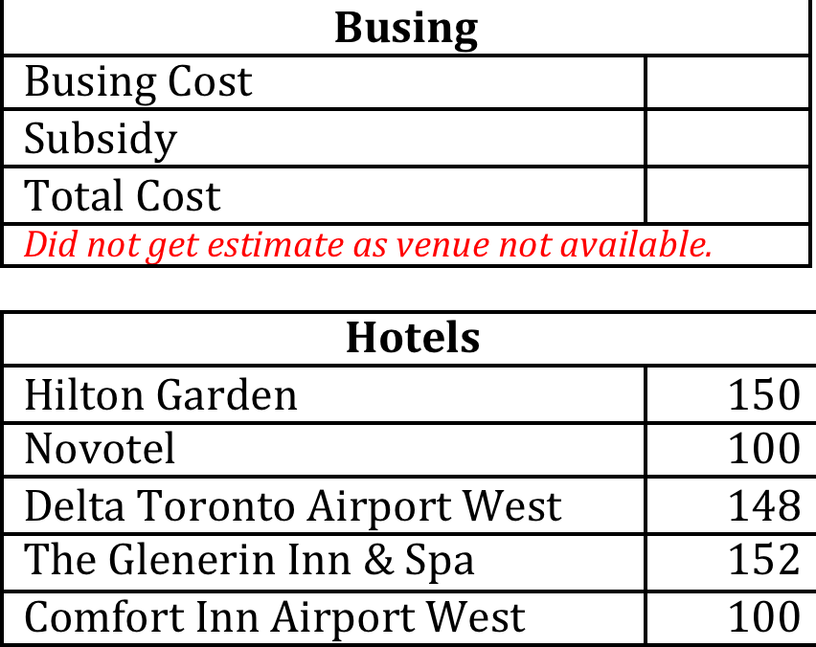
Mississauga

Slide 19
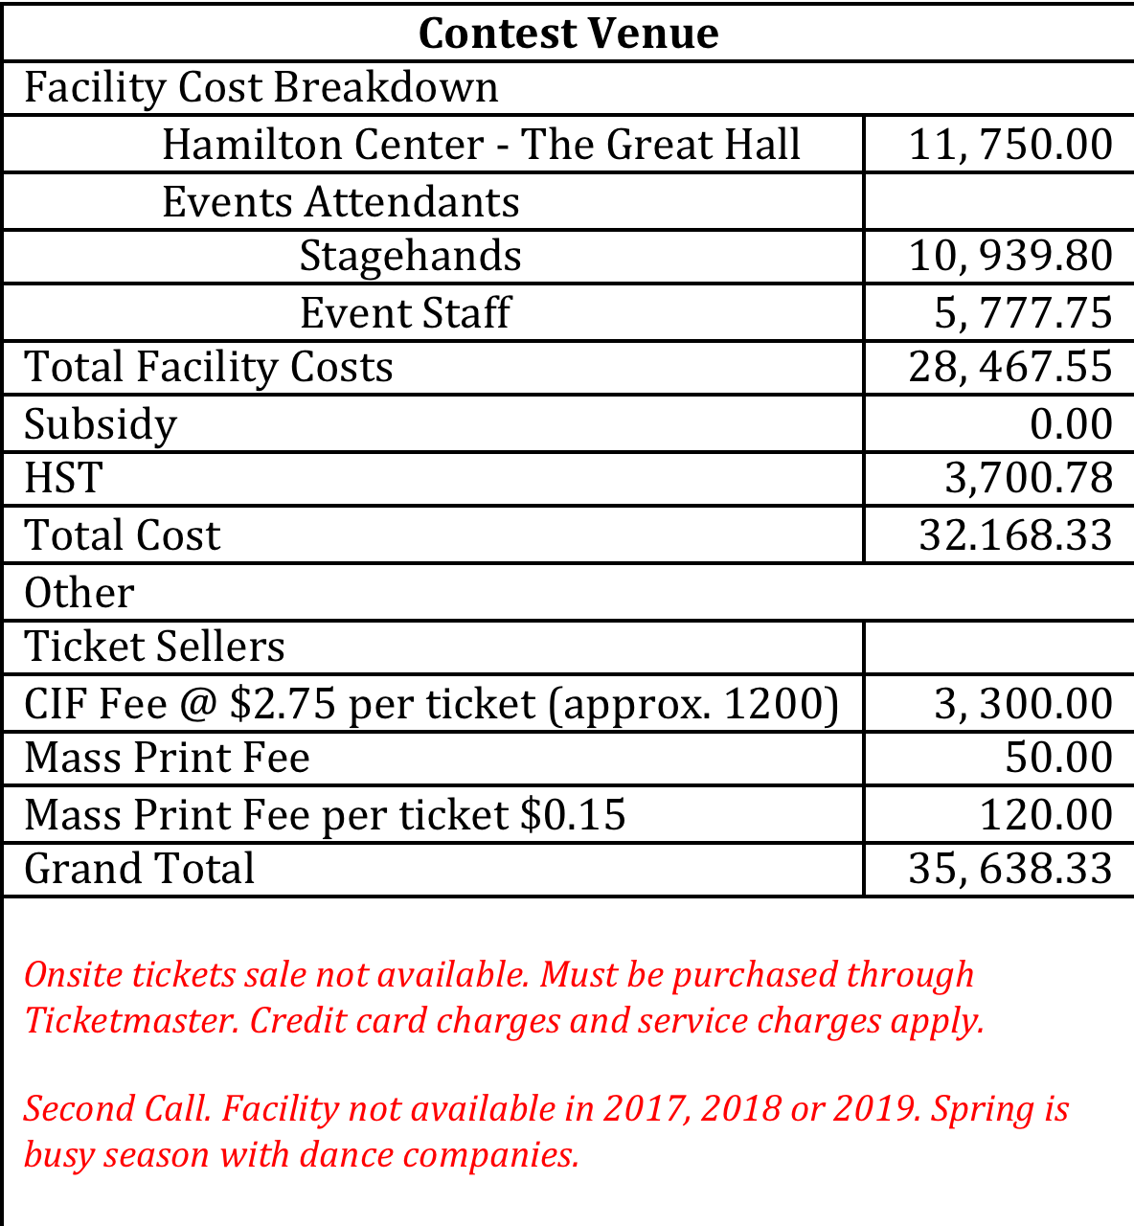
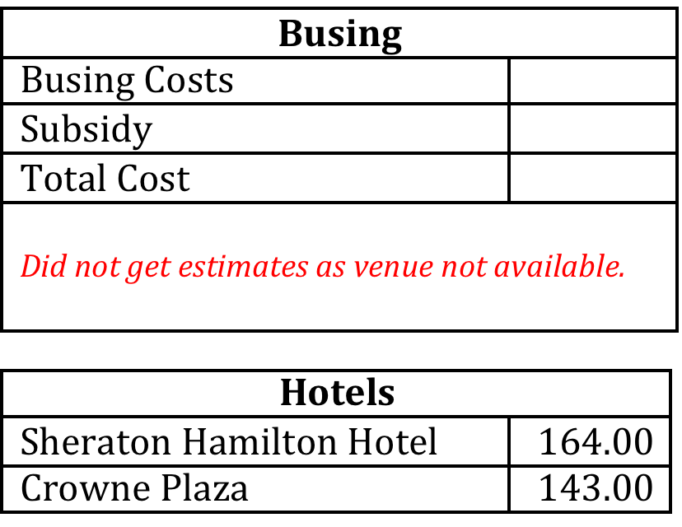
Hamilton

Slide 20
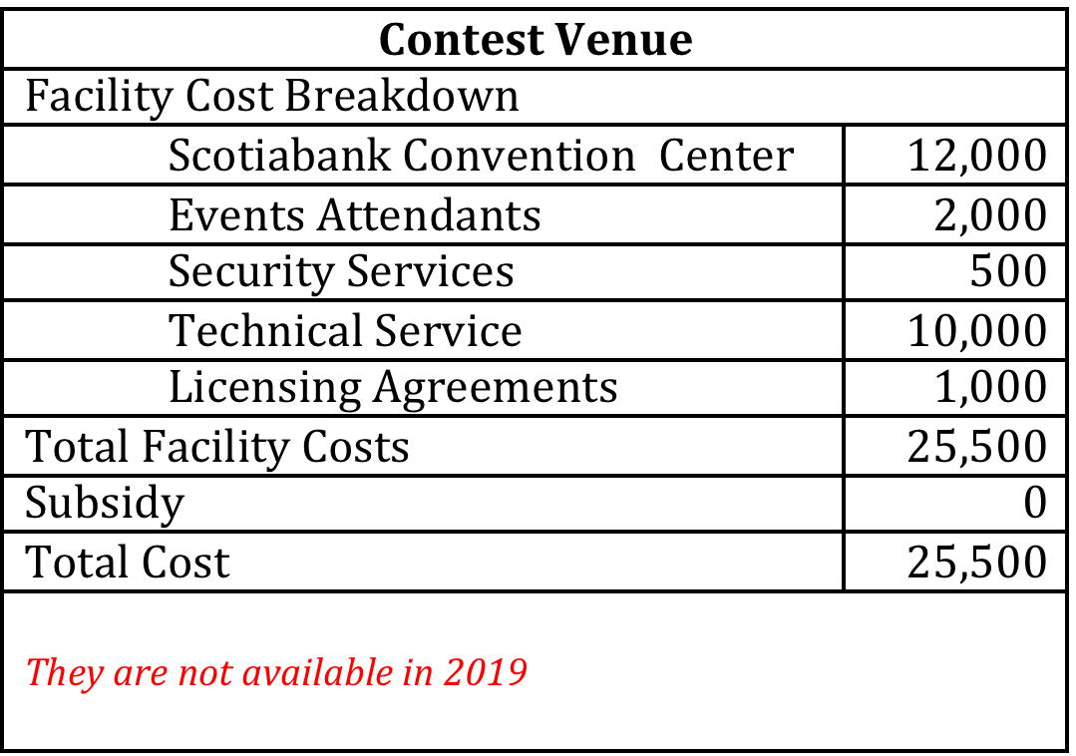
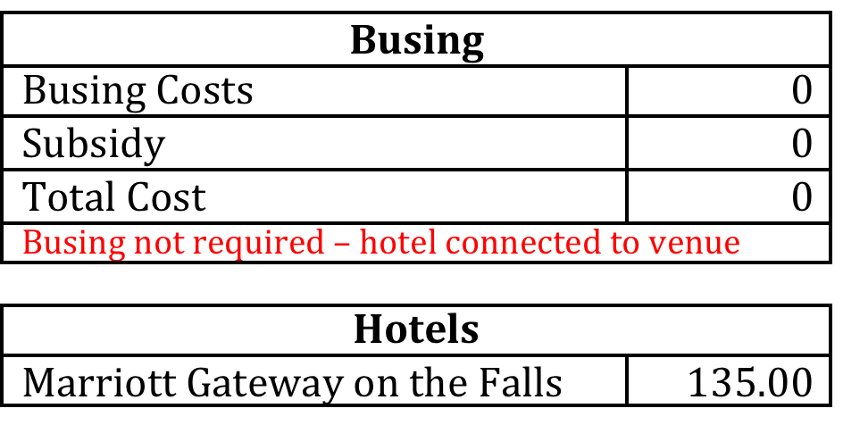
Niagara Falls

Slide 21
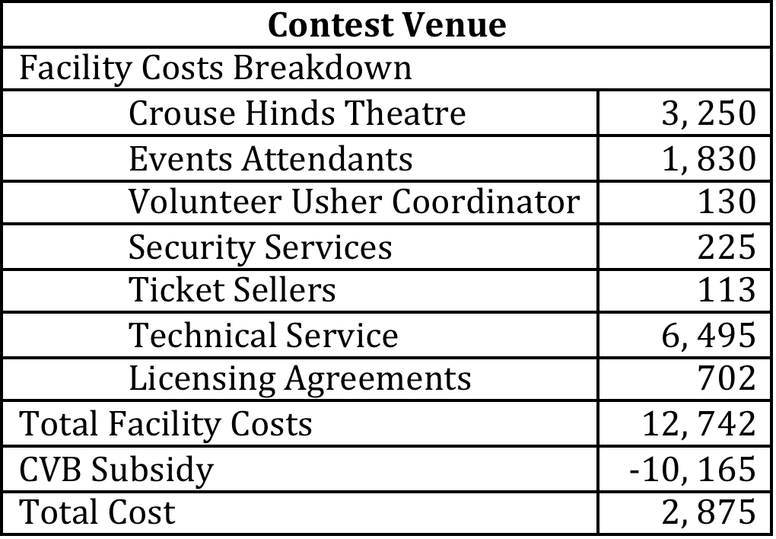
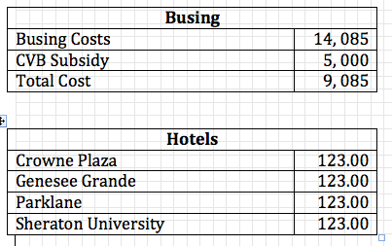
Syracuse

Slide 22
Conclusion
Contracts signed with City of Syracuse facilities for contest 2015 & 2016
Taking cost of facilities and other associated expenses, Task Force has recommended Syracuse for contest 2017, 2018 & 2019
RMT has approved the recommendation

